Slide 1
Build Android native apps with the Microsoft Graph Java SDK
Integrate the Microsoft Graph Java SDK into an app

Slide 2

Building Microsoft Graph applications
Microsoft Graph Java SDK
GraphServiceClient
Making Requests

Slide 3
Microsoft Graph Java SDK
Microsoft Graph REST API always available to all application types
Microsoft Graph SDK abstracts the specifics of calling the REST API
https://github.com/microsoftgraph/msgraph-sdk-java
Handles updating HTTP request headers and other details required by the REST API
Provides a fluent API for creating Microsoft Graph requests
IEventCollectionRequest request = graphClient
.me()
.events()
.buildRequest(
Arrays.asList(
new QueryOption("$select", "subject,start,end"),
new QueryOption("$top", "20"),
new QueryOption("$skip", "0"))
);
Notes:
Developers can leverage the Microsoft Graph REST API in any type of application
All it requires is standard HTTP requests - check out the Android HTTP library Volley for these use cases
Microsoft also provides a native Android SDK for the Microsoft Graph
Abstracts the details of working with a REST API
SDK provides a fluent API for creating requests

Slide 4
Integrating Microsoft Graph for Android apps

Slide 5
Add Microsoft Graph’s Java SDK to the App
Microsoft Graph provides an Java implementation of the SDK
Similar to the MSAL SDK, use Gradle to add the Microsoft Graph Java SDK to the project
See SDK documentation for additional steps depending on the size of your project
implementation 'com.microsoft.graph:microsoft-graph:1.0.+'
Notes:
Just like the Azure AD MSAL Android SDK…
The Microsoft Graph team provides an Android SDK for native Android applications
Add this to your project using Gradle
Gradle is a build & package management tool commonly used in Android development
Similar to MSBuild + NuGet in a .NET project
Also add the GSON library, an open source library to help with serialization & deserialization of Java & JSON objects
Depending on the size of the application, you may need to enable ProGuard and multidexing on your project
Due the fact the Microsoft Graph Android SDK uses a large number of classes to describe functionality
See the project documentation for details: https://github.com/microsoftgraph/msgraph-sdk-android

Slide 6
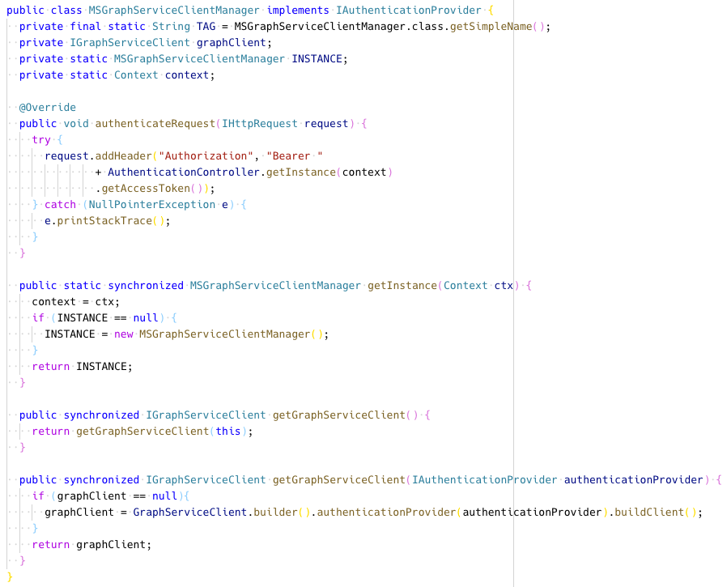
Recommendation: Consider Using a Singleton to Manage the API
Notes:
Most applications will only need a single instance of the GraphServiceClient for calling the Microsoft Graph
To simplify this process, consider creating a singleton to manage this process
Note that you need to override requests that are sent to add the access token to the request using the IAuthenticationProvider.authenticateRequest(IHttpRequest) method

Slide 7
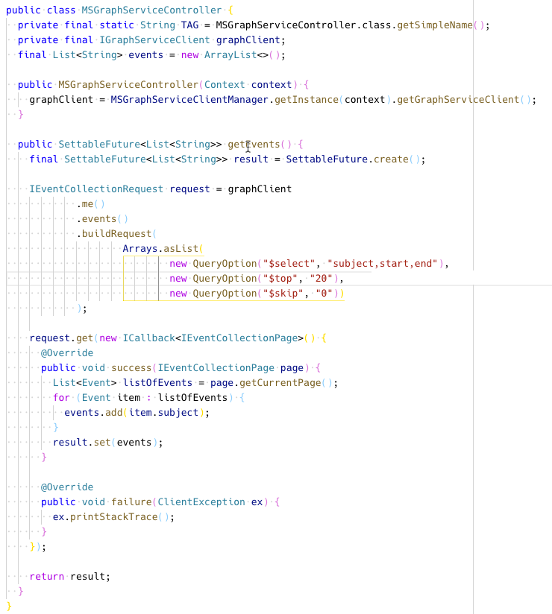
Use the Microsoft Graph Java SDK
Notes:
Calling the Microsoft Graph with the GraphServiceClient object is very straightforward.
Use the fluent API to build a request
The buildRequest() method allows you to add options to the OData query that will be sent to the REST API
Note for new Android developers:
Android uses a set of objects with “Future” in the name to be used in callbacks
For example this code uses a SettableFuture similar to async/await in .NET or Promises in JavaScript/TypeScript

Slide 8
Demo

Slide 9
Thank you.

